Slide 1

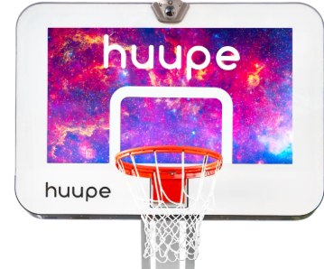
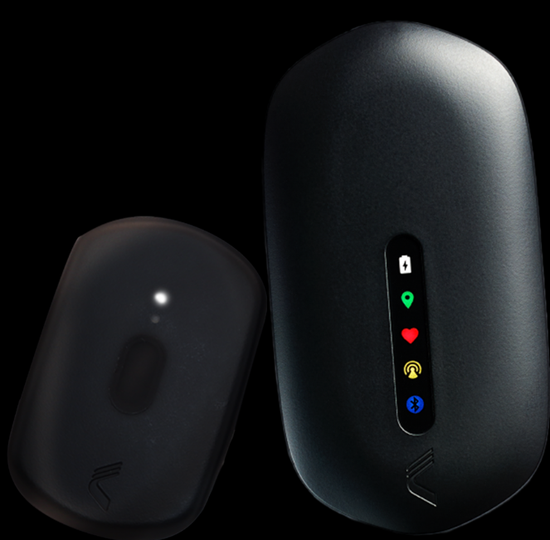
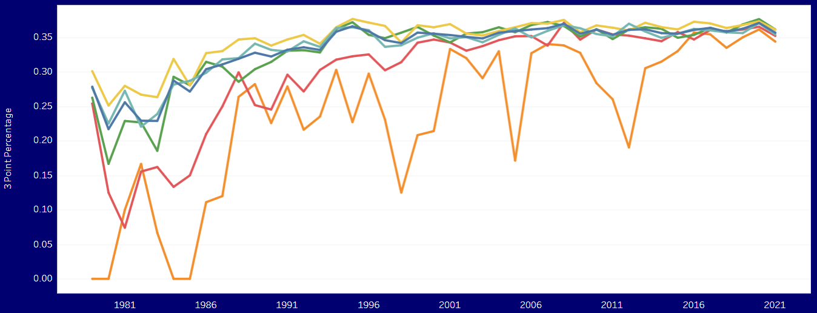
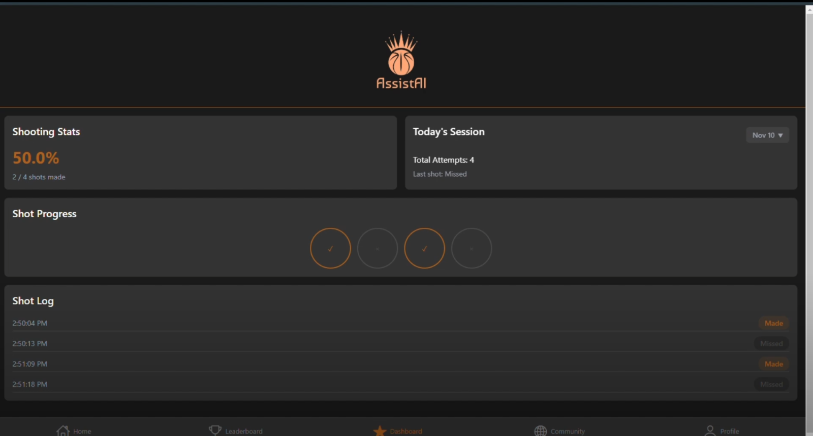
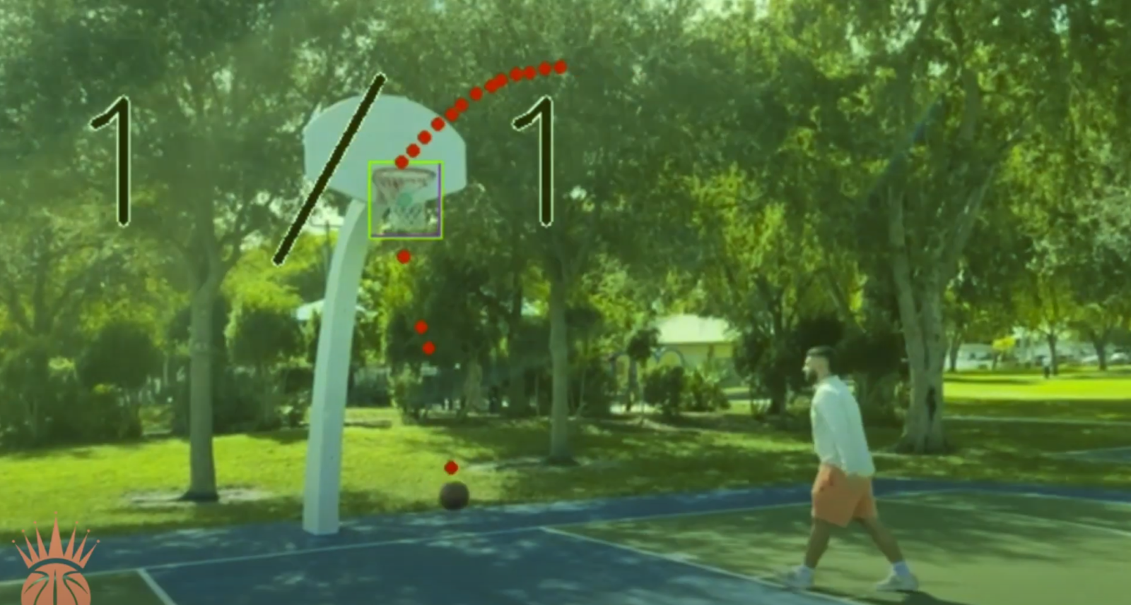
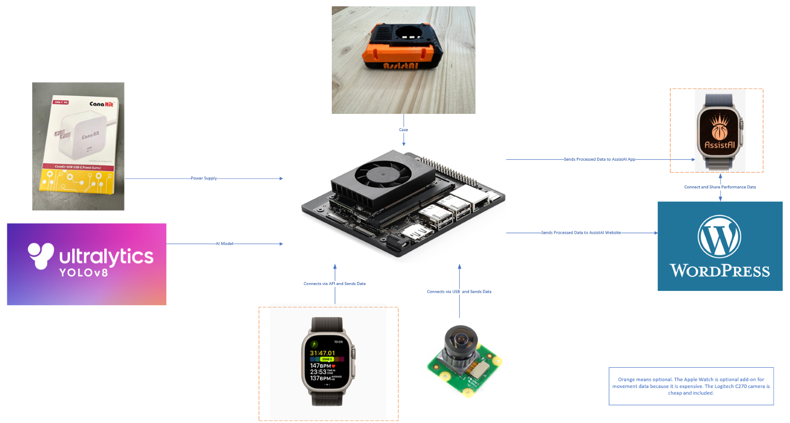
Florida International University Engineering and Computing
2024 Fall Senior Design Project
Assist AI Basketball Performance Monitoring
Students: Hannah Reigi, Aaron Gil, Obailu Keen, Ruben Nodarse, Gabriel Johnson
Mentor: Dr. Md Tauhidur Rahman, Florida International University
Instructor/Faculty: Dr. Wilmer Arellano, Florida International University
Sports are more competitive than ever, with players and teams striving to gain every possible edge in performance and strategy. Advanced analytics have become essential to understanding player strengths and identifying areas for improvement. However, many sports analytic tools are prohibitively expensive, limiting accessibility for amateur athletes.
Average Performance of Professional Athletes Over Time
Historical Average NBA Player | Tableau Public
Catapult and Huupe offer solutions to both amateurs and pros that want to improve their performance and increase competitiveness in basketball. These products range from $799 to several thousand dollars.
REQUIREMENTS
High-Speed Processing
Affordability
User Friendly Graphical Interface
Accuracy
Durability
Performance data capture by our camera vision algorithm and wearable device are packaged into JSON files and sent to our host domain. Here, we display data such as shots taken, missed, real player shooting accuracy, along with other health metrics such as speed, heart rate, and overall player agility. Our straightforward analysis gives players a new insight to potential areas of improvement.
The AssistAI system is built upon an Nvidia core processor operating in congruence with the Arducam to monitor player performance. The optional apple watch feature similarly tracks player health stats. Performance analysis are subsequently updated to our GUI in nearly-real time.
Utilizing YOLOv8 real-time object tracking, our camera vision algorithm delivers cutting edge performance in accuracy and speed.
SUMMARY
VERIFICATION
REFERENCES
ACKNOWLEDGEMENT
The material presented in this poster is based upon the work supported by XXXXX (name of the project sponsor: federal, state or local government, or corporate partners, where applicable). We/I thank XXXX for his/her/their assistance and mentorship that I/we received throughout the senior design project.

